Slide 1
SMARTIE
A Smarter Way of Building Intelligent AI Bots
https://smartie-ai.web.app/

Slide 2
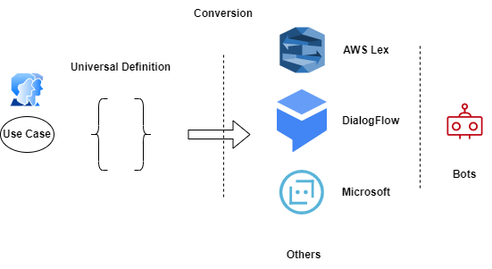
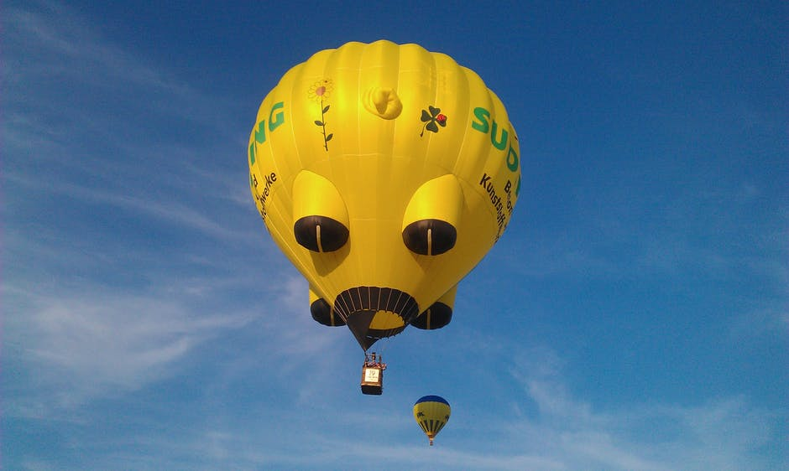

Universal Layer
Universal Bot definition is most innovative of storing a bot definition. Conversion Api can convert this universal bot definition to any of the bot services on a single click.
https://smartie-ai.web.app/

Slide 3
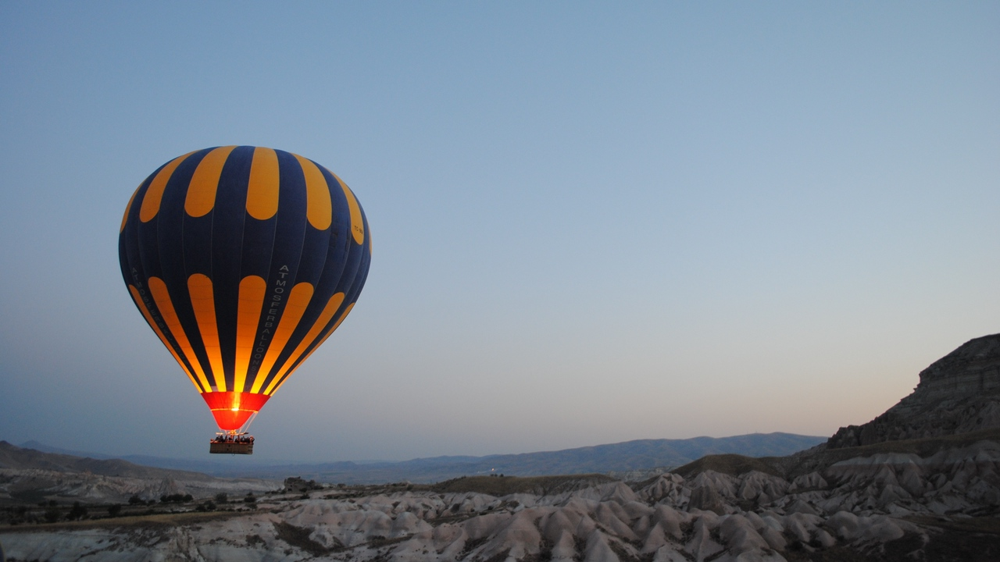
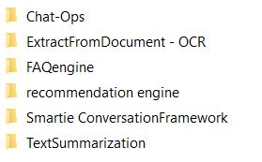

Our Motivation.
Components
Intelligent Bots with AI
ML - Recommendation Engine
RL - Enhance User experience and interactions
FAQ - Easily Built FAQ engine for answering FAQs
OCR - Extract text from PDF/Image.
NLP - Advance NLP features.
Bert - Summerization
Bert - Wiki bot
Strong & Advance
Language Model AI Bots
Powered by Advance AI/NLP
We use most advance and reliable azure services for building AI assistant.

Slide 4
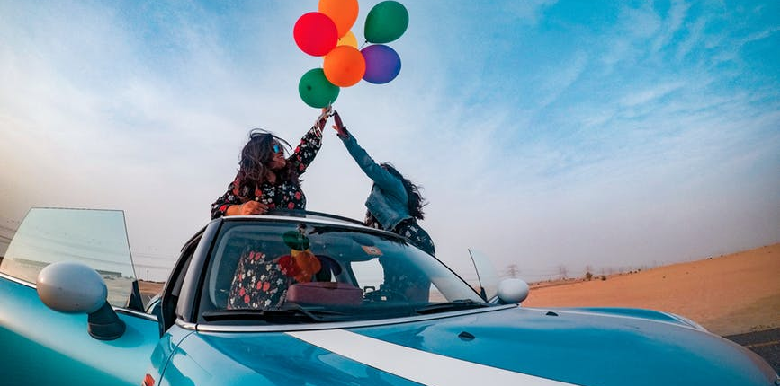
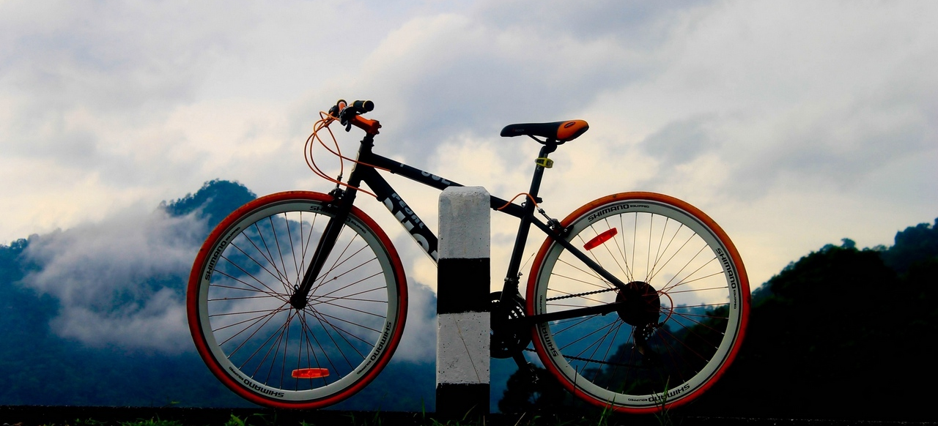

ML - Machine Learning
Affordable AI
metaverse
Recommendation Engine
Configurable Engine
Low Shot Learning
Capable of recommending best products to user
Easily configure so the our model can recommend and learn about new products
With out Low Shot learning our ML models works efficiently with low data.
High Performance
Innovatife & Creative
Give Smart Solution

Slide 5
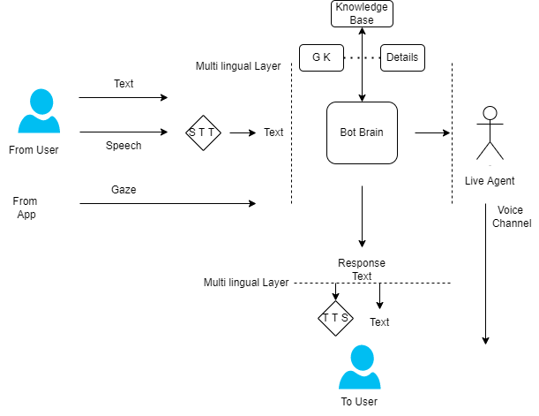
ARIA AI Bot
ARIA Bot
Most advance AI Voice / Chat Bot powered by AI
Note: Actual architecture may slightly change w.r.t different azure services and capabilities.

Slide 6
UseCases.
ARIA - Classrooms
Swiggy Bot
Youtube Content Creator
Highly innovative
Innovatife & Improvise Banking
Health Care Innovation

Slide 7

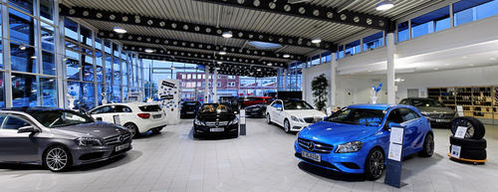





Capabilities
Students
Employees
Can learn more effectively
Can learn very fast
Guided Virtual Tours, Collaborative Tours ( ARIA together )
HR policies, Office Walkthrougs etc
Internet User
Metaverse User
Enriched Understanding
ARIA Study, ARIA Narration
Any information in internet can be consumed more effectively
Schools, Students, Personalization

Slide 8

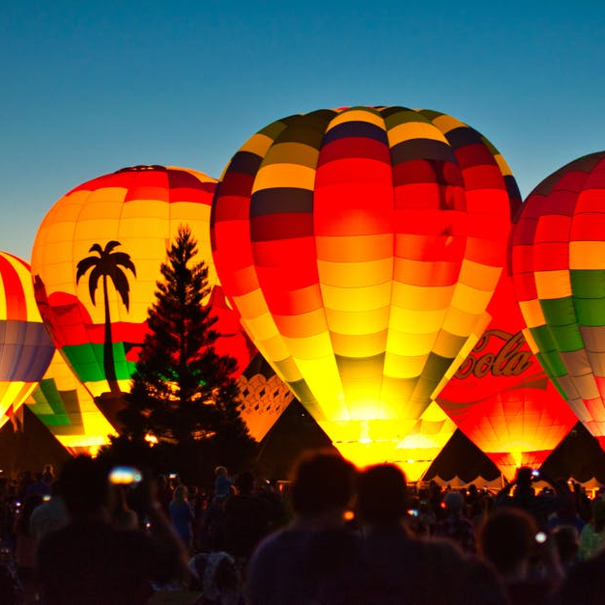




About Us.
Team
Transform Learning/business
with AI.
Passionate Team
Experienced developers
Built with open source
5
50
Customer
Validation done
Finished Project
Happy Customers

Slide 9
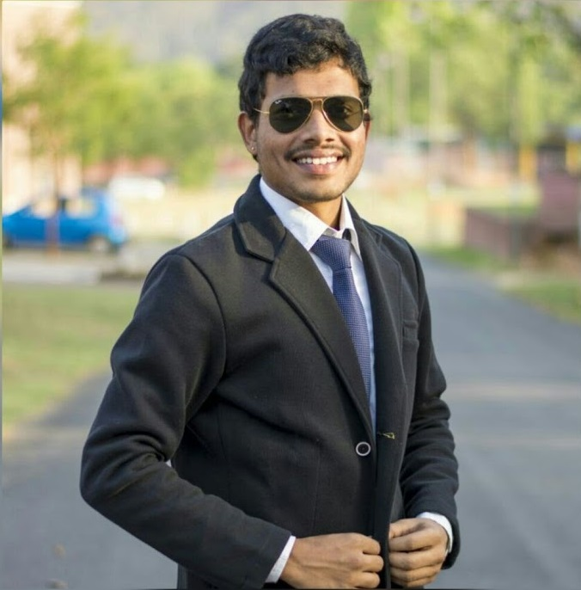




Super Team.
Modern
Team
Yeshwanth Sai
Kiran Kumar
Founder and developer
Developing Skills
90%
Developing skills
90%

Slide 10
About ME.
Strong leadership
Yeshwanth Sai
Founder and Developer
Modern
“
Always deliver more than expected.
”
Marketing
80%
Selling
95%
Team Building
90%

Slide 11
World wide languages. (Scale at Ease)
Russia
Europa
Modern
Engish
Asia
Africa
Australia
We can support 119 languages world wide

Slide 12
Thank You.
Virtual Reality meets Artificial Intelligence
ARIA

